Slide 1
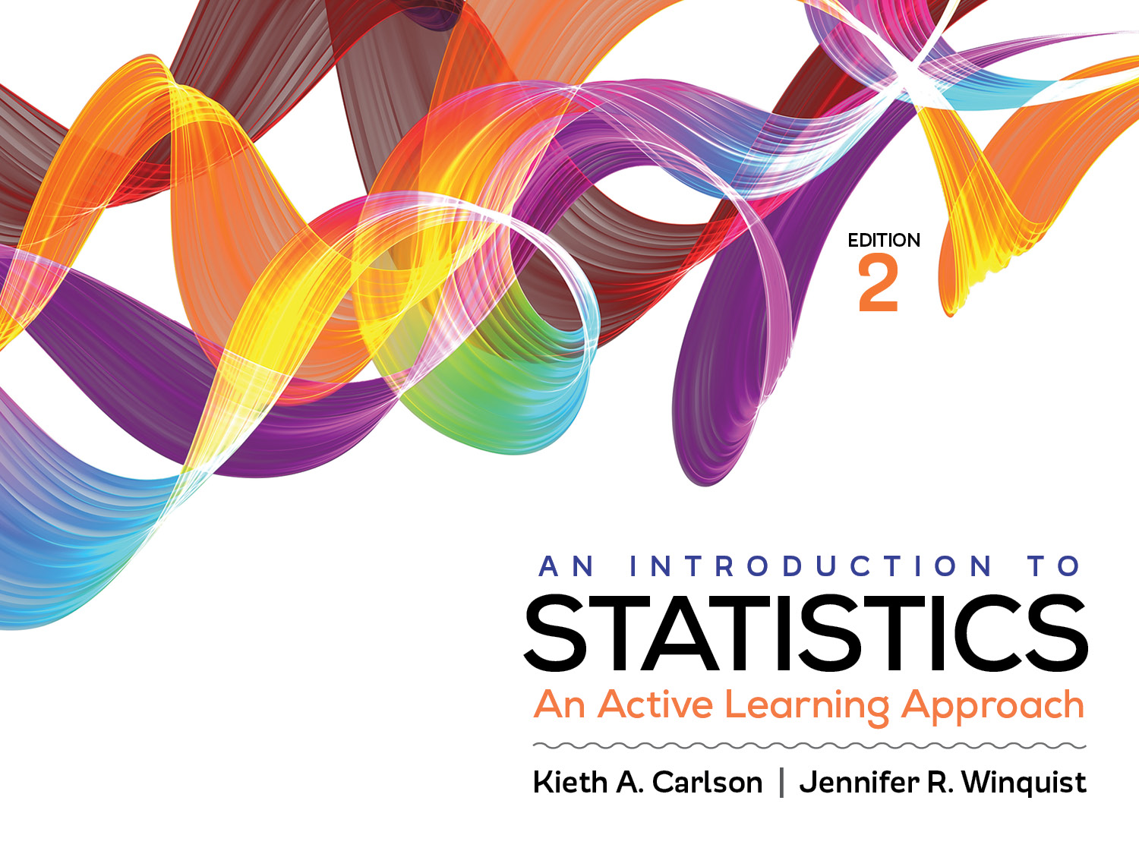
Introduction to Activity 5.1
Distribution of Sample Means

Slide 2
Activity 5.1 will require you to:
Describe a distribution of sample means
Explain how it is different than a distribution of raw scores
Find the mean and SD of a distribution of sample means
Estimate sampling error using the standard error of the mean
Describe how you could decrease sampling error
State the central limit theorem and why it is important

Slide 3
Sampling error
Why do researchers use samples when they are really interested in populations?
What problem does this create for researchers?
So if I was using a sample mean to infer the value of the ___________ _________, sampling error would be . . .
You can predict how much sampling error to expect in a given study by computing the ____________________________.
Notes:
Researchers use samples because, most of the time, populations are too big to study, so they obtain representative samples and infer that the values they get from the sample will be “close to” the values they would get if they studied the entire population.
Using samples creates the problem of sampling error. So, if I was using a sample mean to infer the value of the population parameter, sampling error would be the difference between the sample statistic and the population parameter values.
You can predict how much sampling error to expect in a given study by computing the standard error of the mean (the standard deviation of the distribution of sample means).

Slide 4
Distribution of sample means
A collection of all possible random samples of a given size (N) from a population.
Activity 5.1 walks you through creating a distribution of sample means by hand from a small population with a small sample size
Then, you will use an Applet to simulate larger populations and sample sizes.
http://onlinestatbook.com/stat_sim/sampling_dist/

Slide 5
Creating a distribution of sample means
Population distribution
Distribution of sample means (N = 25)
µ = 50, σ = 10

Slide 6
Creating a distribution of sample means
Population distribution
Distribution of sample means (N = 25)
Take sample of n = 25
& plot its mean (M)
µ = 50, σ = 10
42 44 46 48 50 52 54 56 58

Slide 7
Creating a distribution of sample means
Distribution of sample means (N = 25)
Population distribution
µ = 50, σ = 10
Do it again
42 44 46 48 50 52 54 56 58

Slide 8
Creating a distribution of sample means
Population distribution
Distribution of sample means (N = 25)
µ = 50, σ = 10
Do over and over and over
and over and over . . .
42 44 46 48 50 52 54 56 58

Slide 9
Creating a distribution of sample means
Distribution of sample means (N = 25)
Population distribution
µ = 50, σ = 10
Until you get a . . .
Notice the difference in scale between these two distributions—why does this make sense?
Notes:
Be sure to point out the differences of scale between the two distributions on this slide. The distribution of sample means on the right is far less variable than the distribution of raw scores on the left. Means vary much less than scores.

Slide 10
Distributions of sample means
What are the characteristics of every distribution of sample means?
Central Limit Theorem
Their mean will always be equal to the population mean (µ)
Their standard deviation will always equal to the standard error of the mean (σ/√N)
Their shape will tend to be normal as N increases; in practice if n ≥ 30 it will be normal unless the original population is very skewed.

Slide 11
Creating a distribution of sample means
Population distribution
Distribution of sample means (N = 25)
µ = 50, σ = 10
CLT tells us . . .
Notes:
Point out that actually creating a distribution of sample means would be practically impossible when the population is large (as most are). This is why the Central Limit Theorem is so important. It tells us the characteristics of every distribution of sample means without us having to do all the work (we don’t have to actually build it).

Slide 12
Standard Error of the Mean (SEM)
The typical distance between all possible sample means and the population mean.
SEM = σ/√N
So, the SEM is a measure of typical or expected _________ ________.
How can you reduce sampling error?
Notes:
The SEM is a measure of typical or expected sampling error.
You can reduce sampling error by (1) measuring a variable more accurately (reducing σ) or by (2) increasing the sample size (N).

Slide 13
Goals for Activity 5.1
Really know what a distribution of sample means is. You should really understand it, not just know the definition.
Know how to find the mean, standard error of the mean, and shape of every distribution of sample means (i.e., know CLT)
Understand how sample size influences the standard error of the mean and how this relates to sampling error.

